Slide 1
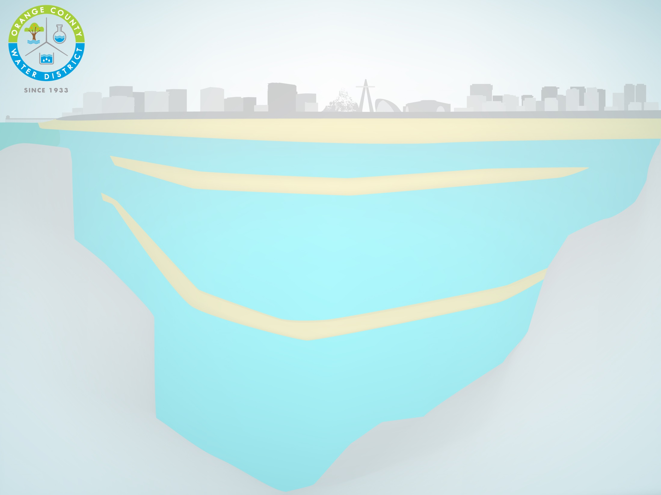

Learn how OCWD takes the limited water supply found in nature and supplements it to provide water for 2.4 million+ residents and businesses in Orange County

Slide 2

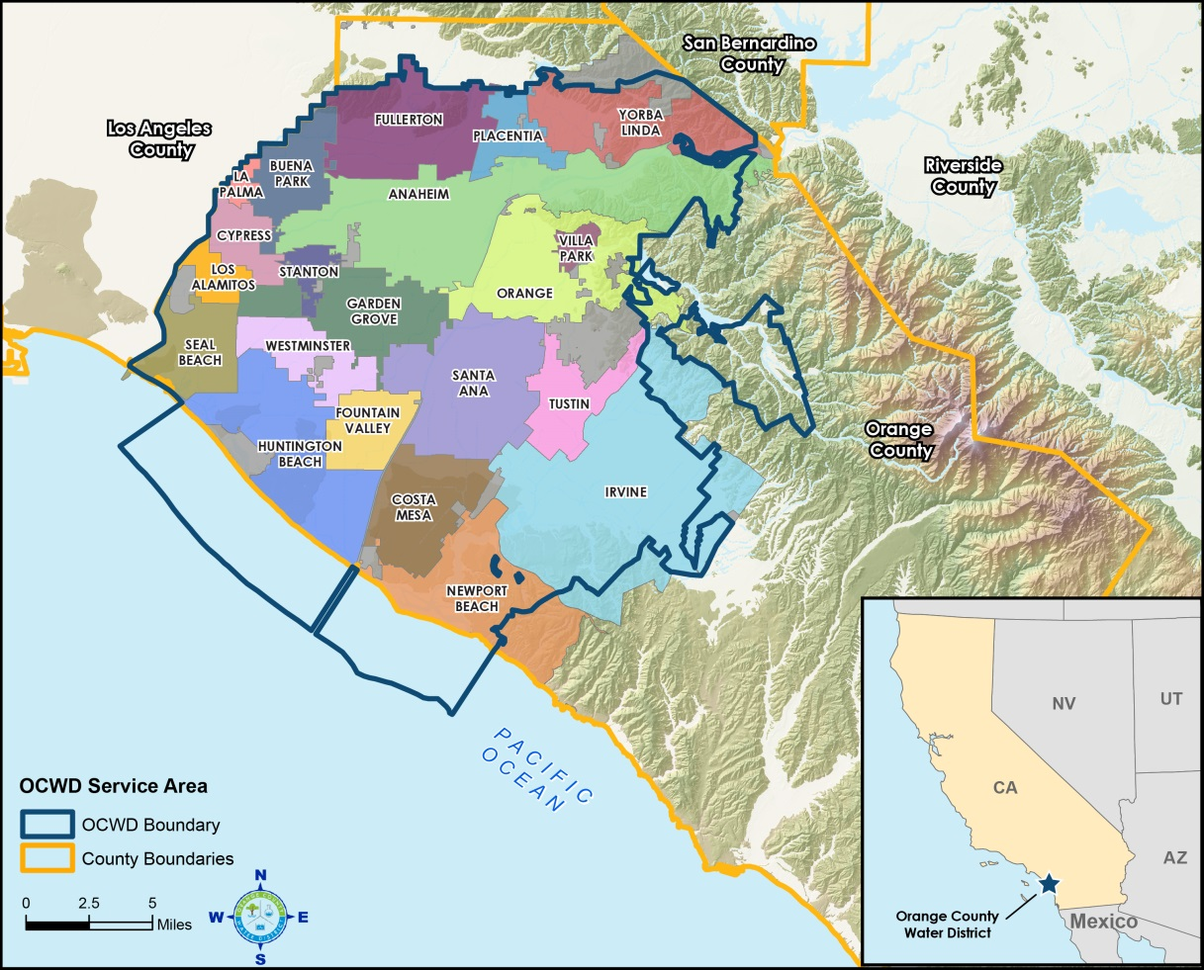
Serves 2.4 million people
Manages & replenishes OC Groundwater Basin
Ensures water reliability & quality
Protects OC water rights to Santa Ana River
Internationally recognized

Slide 3

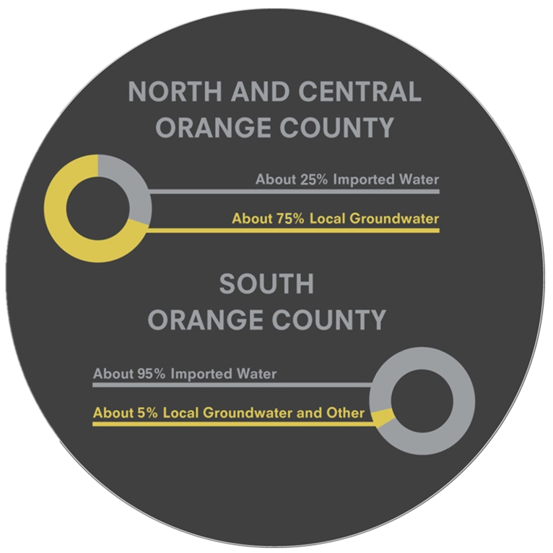

Slide 4

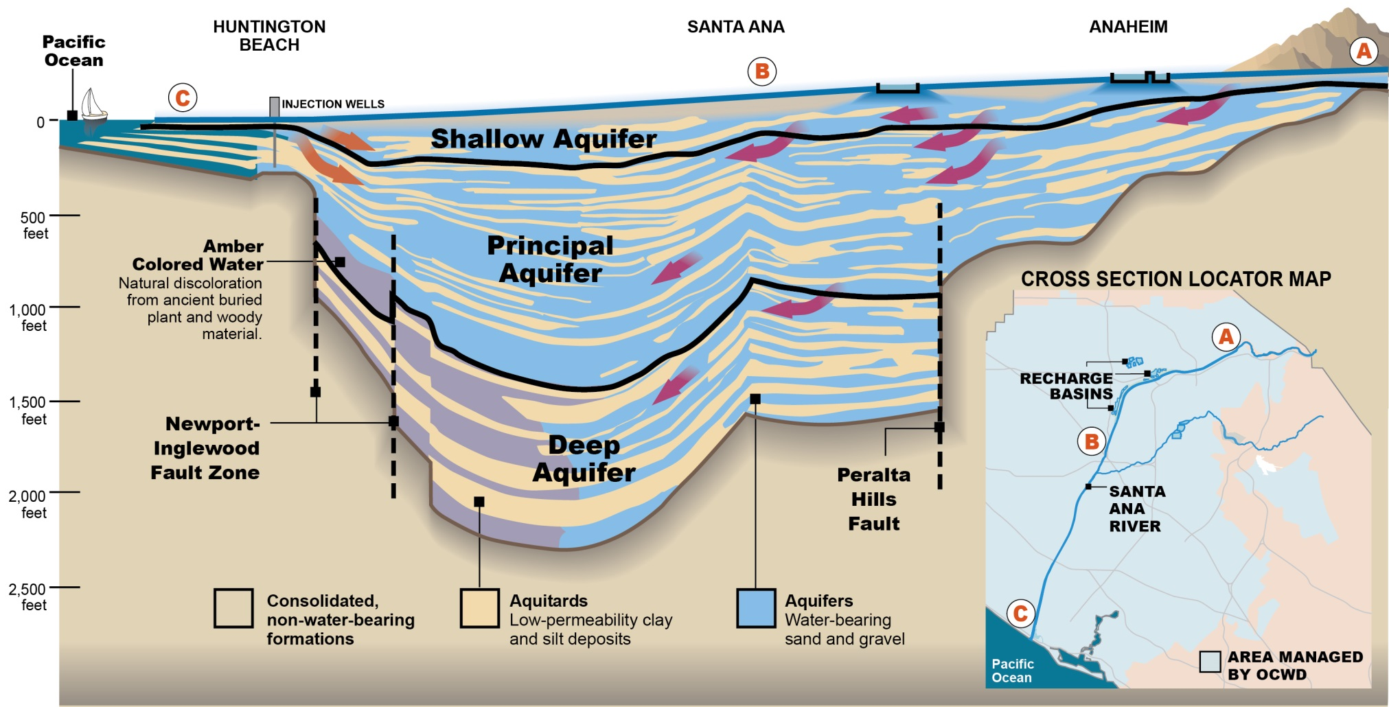

Slide 5
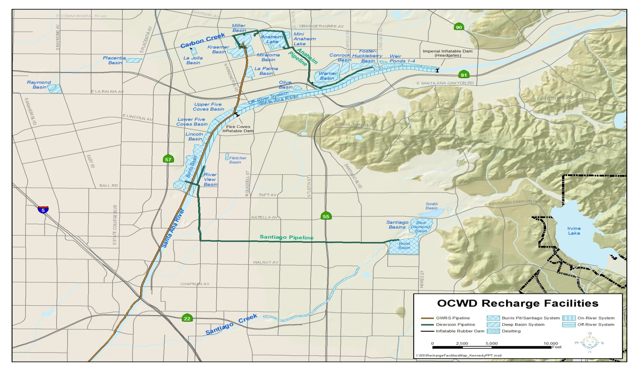
1,100 acres of recharge facilities (44km²)
~ 250,000 afy of recharge into groundwater basin (308 million m³/year)

Slide 6

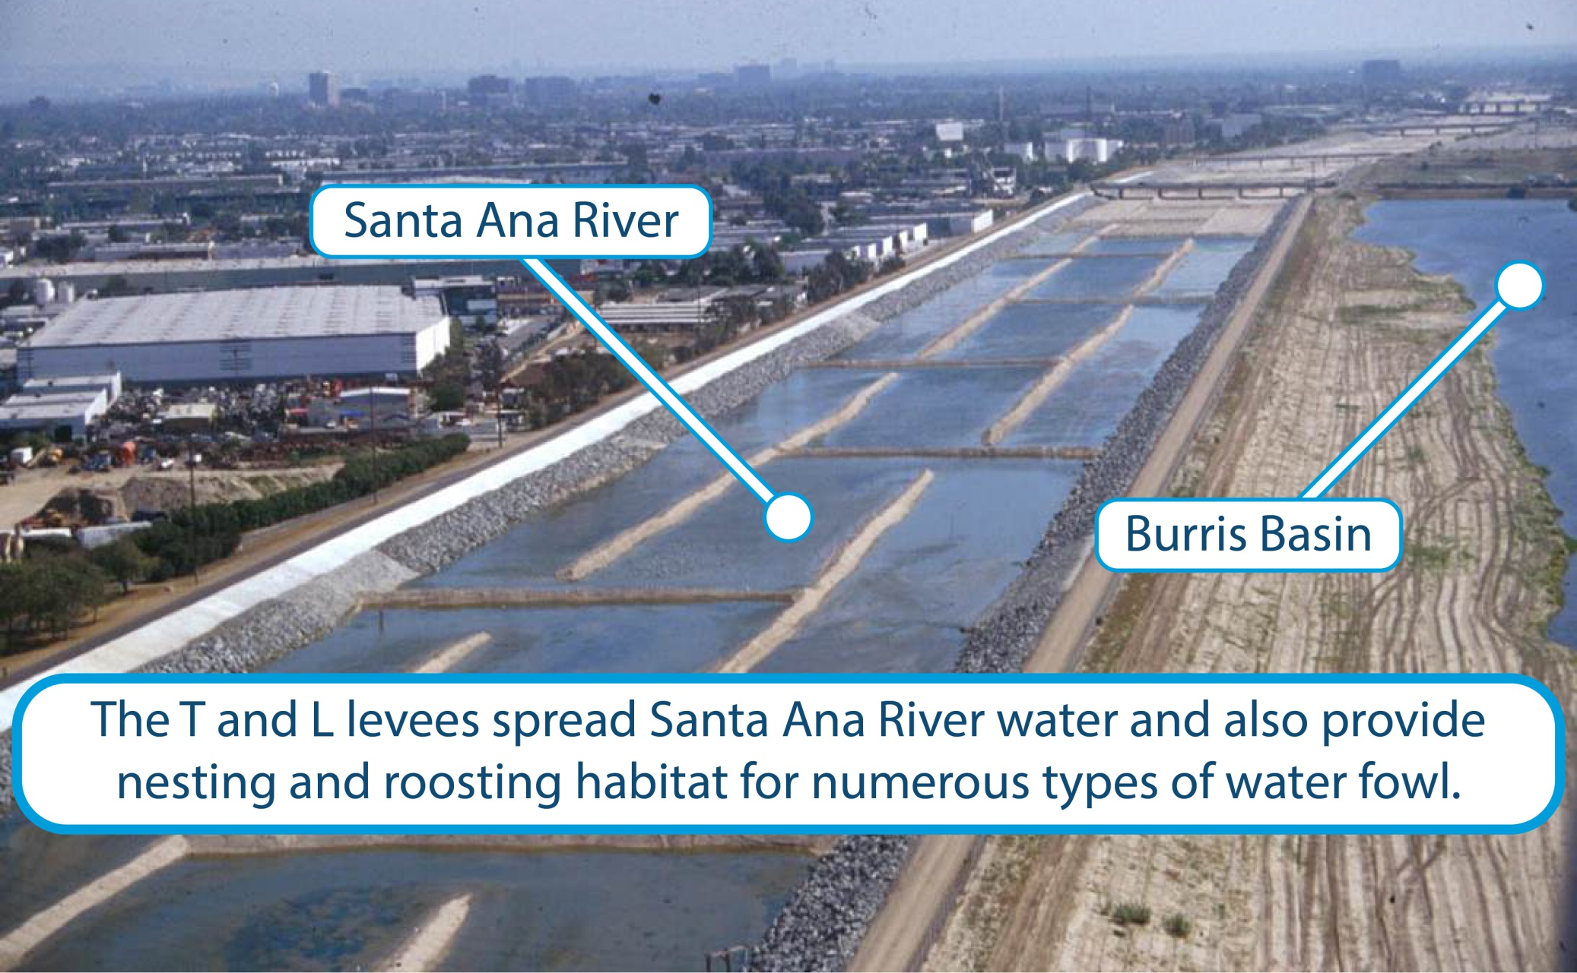

Slide 7

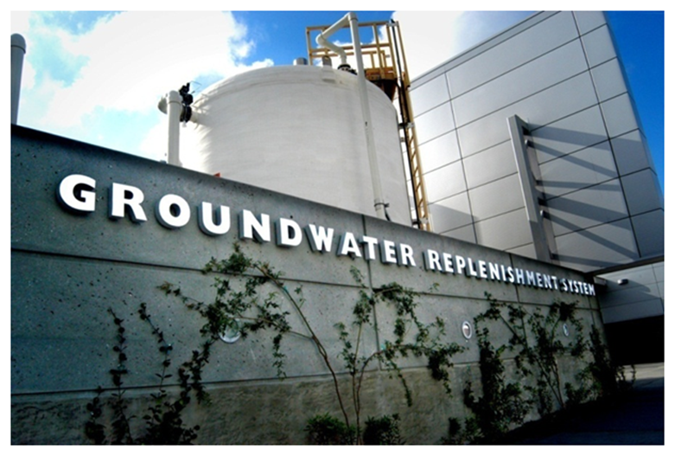
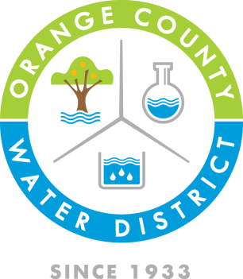

Advanced Water Purification
100 million gallons/day (MGD)
Purifies treated sewer water
A new source of water
Joint project with OCSD
Controversial for its time
$623 million
Final Phase will add 30 MGD

Slide 8
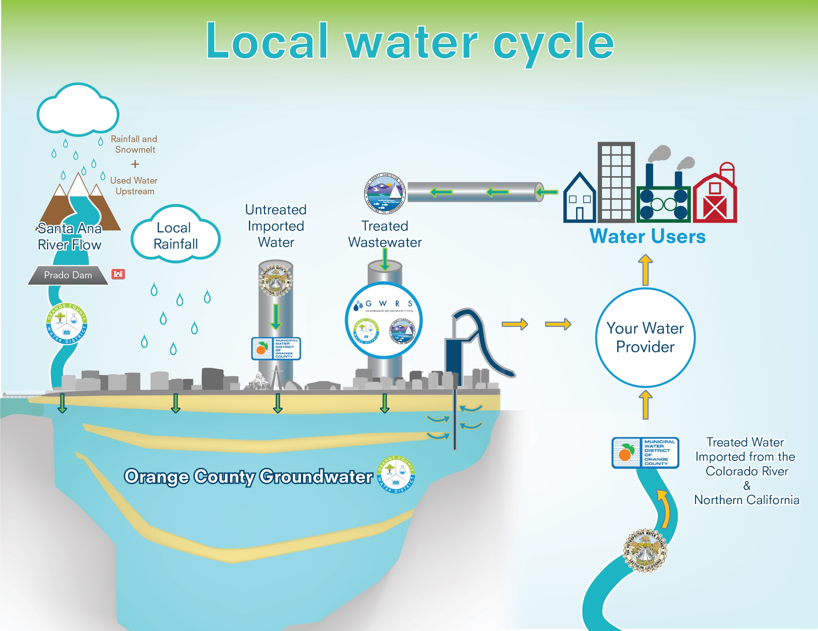

Slide 9
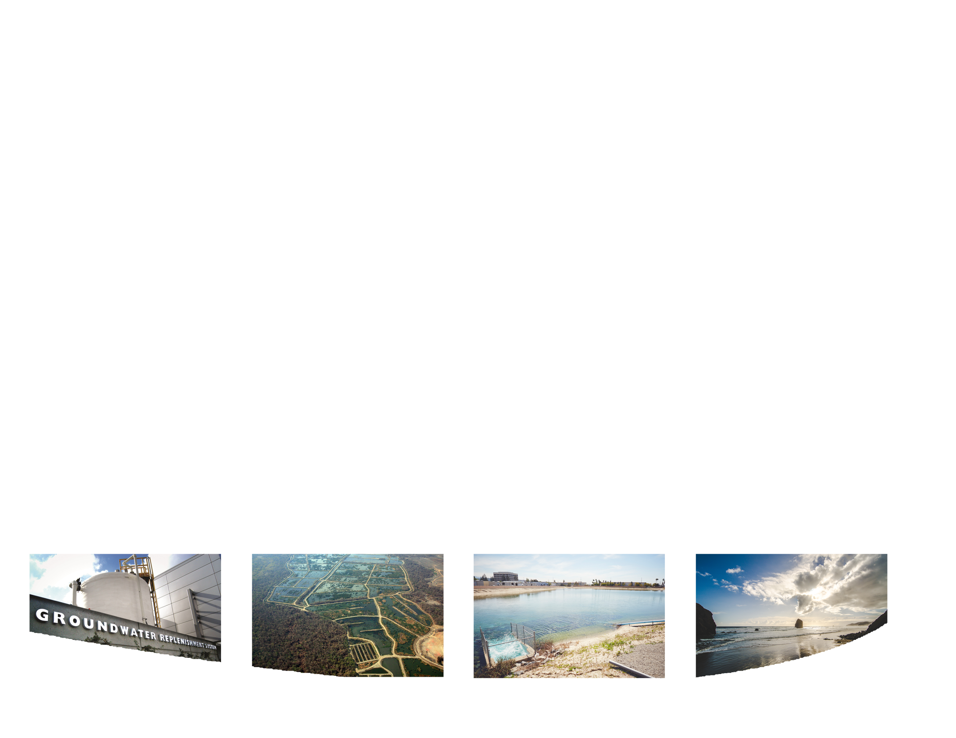

Expand GWRS
Increase stormwater storage behind Prado Dam
Water efficiency and conservation measures
Explore MET indirect potable reuse project
Explore ocean water desalination.

Slide 10

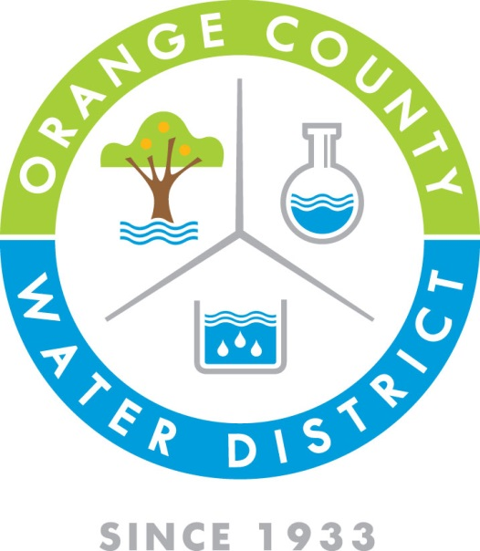



To sign up for tours or for more
information, visit us at www.ocwd.com.
To receive our newsletter, please leave your
card with our staff member.
Questions? Please call 714-378-8244.
Facebook.com/OCWaterDistrict
@OCWDWaterNews
@OCWD

